Slide 1

DATA ANALYSIS USING SQL
Unq_Pizza

Slide 2
DATASET INTRODUCTION
We HAVE 4 excel data sheets in csv format. That are imported in SQL via Import Wizard.
order
order_details
pizzas
pizza_type

Slide 3
Key Field
order.csv | order_details.csv | pizzas.csv | pizza_types.csv
order_id | order_details_id | Category | pizza_type_id
date | order_id | Sub-Category | name
time | pizza_id | Product Name | category
 | quantity |  | ingredients

Slide 4

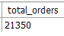
Key Insights
-- Retrieve the total number of orders placed.

Slide 5
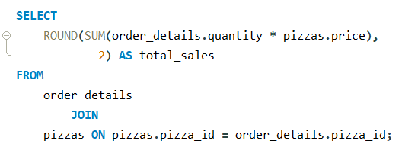
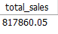
Key Insights
-- Calculate the total revenue generated from pizza sales.

Slide 6
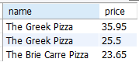
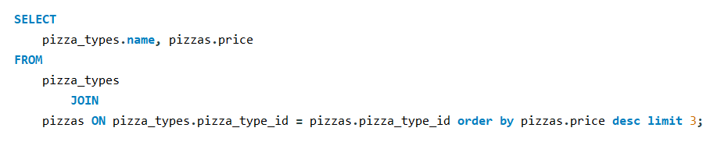
Key Insights
-- Identify the highest-priced pizza.

Slide 7
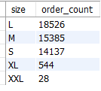
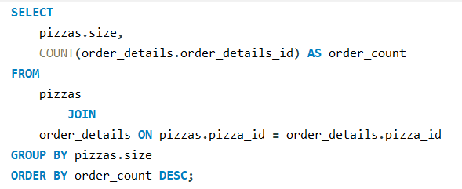
Key Insights
-- Identify the most common pizza size ordered.

Slide 8
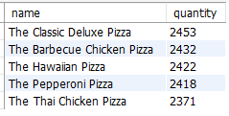
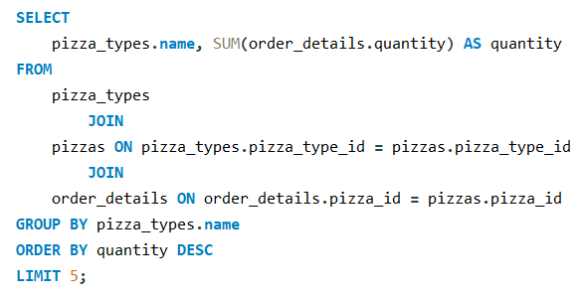
Key Insights
-- List the top 5 most ordered pizza types along with their quantities.

Slide 9
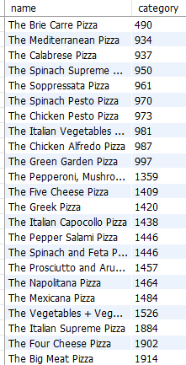
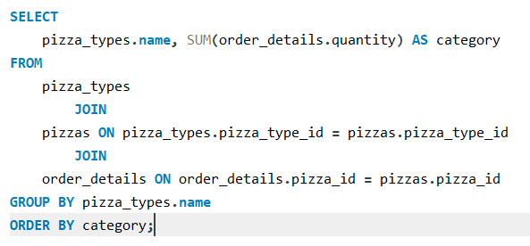
Key Insights
-- Join the necessary tables to find the total quantity of each pizza category.

Slide 10
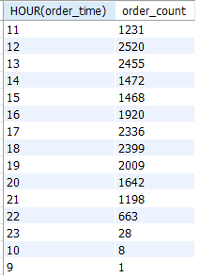
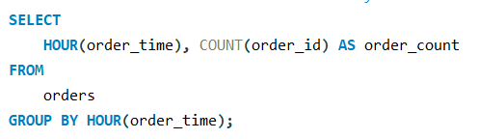
Key Insights
-- Determine the distribution of orders by hour of the day.

Slide 11
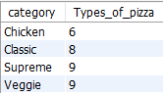
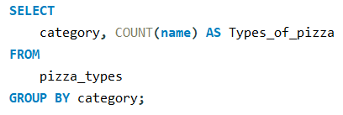
Key Insights
-- Join relevant to find the category-wise distribution of pizzas.

Slide 12
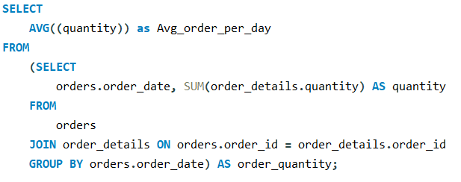
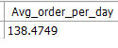
Key Insights
-- Group the orders by date and calculate the average number of pizzas ordered per day.

Slide 13
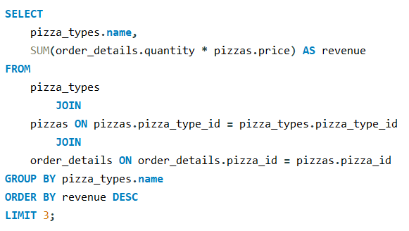
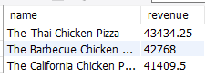
Key Insights
-- Determine the top 3 most ordered pizza types based on revenue.

Slide 14
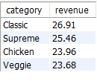
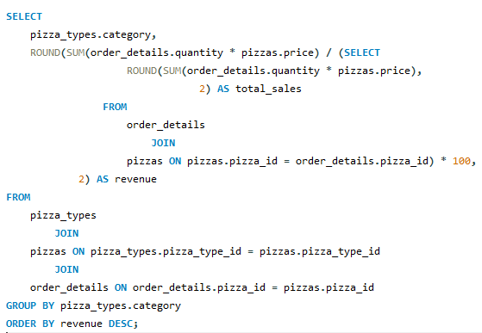
Key Insights
-- Calculate the percentage contribution of each pizza type to total revenue.

Slide 15
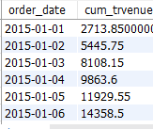
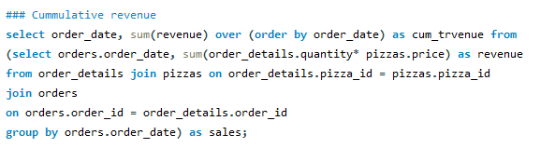
Key Insights
-- Analyse the cumulative revenue generated over time.

Slide 16
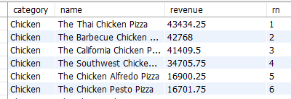
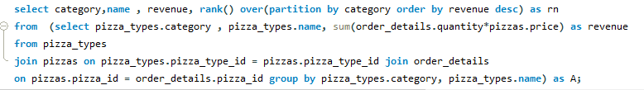
Key Insights
-- Determine the ordered pizza types based on revenue for each pizza category.

